Slide 1
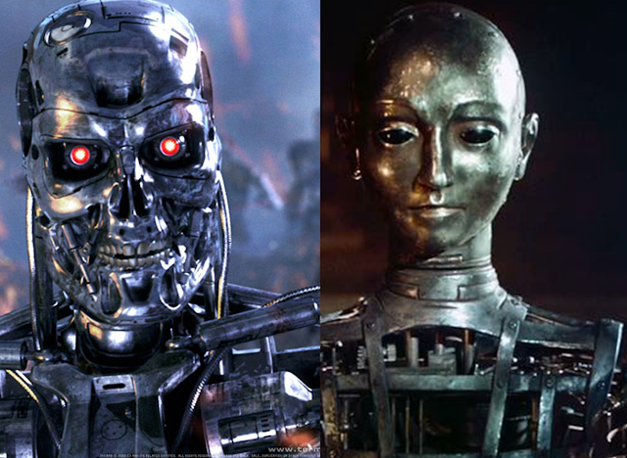
Theory Of Automata

Slide 2
Lecture # 03/04
Theory of Automata

Slide 3
Revision
What is Automata and Automaton?
Application of Theory of Automata
What is a language?
Alphabets and Ambiguity
Words
Strings
Length of string
Reverse of string
Power of string and alphabet

Slide 4
Kleene Star Closure
It is undetermined power, represent infinite number of terms can be made including empty string.
Also known as Kleene Closure and Kleene Operator.
It is denoted by Σ*
It contains infinite words, however each word has finite length.

Slide 5

Examples
If Σ = {x}
Then Σ* = {Λ, x, xx, xxx, xxxx, ….}
If Σ = {0,1}
Then Σ* = {Λ, 0, 1, 00, 01, 10, 11, ….}
If Σ = {aaB, c}
Then Σ* = {Λ ,aaB, c, aaBaaB, aaBc, caaB, cc, ….}

Slide 6
Kleene Plus
It is undetermined power, represent infinite number of terms can be made except empty string.
Also known as Kleene Positive and Positive Closure.
It is denoted by Σ⁺

Slide 7

Examples
If Σ = {x}
Then Σ⁺ = { x, xx, xxx, xxxx, ….}
If Σ = {0,1}
Then Σ⁺ = { 0, 1, 00, 01, 10, 11, ….}
If Σ = {aaB, c}
Then Σ⁺ = {aaB, c, aaBaaB, aaBc, caaB, cc, ….}

Slide 8
Some more examples

Slide 9
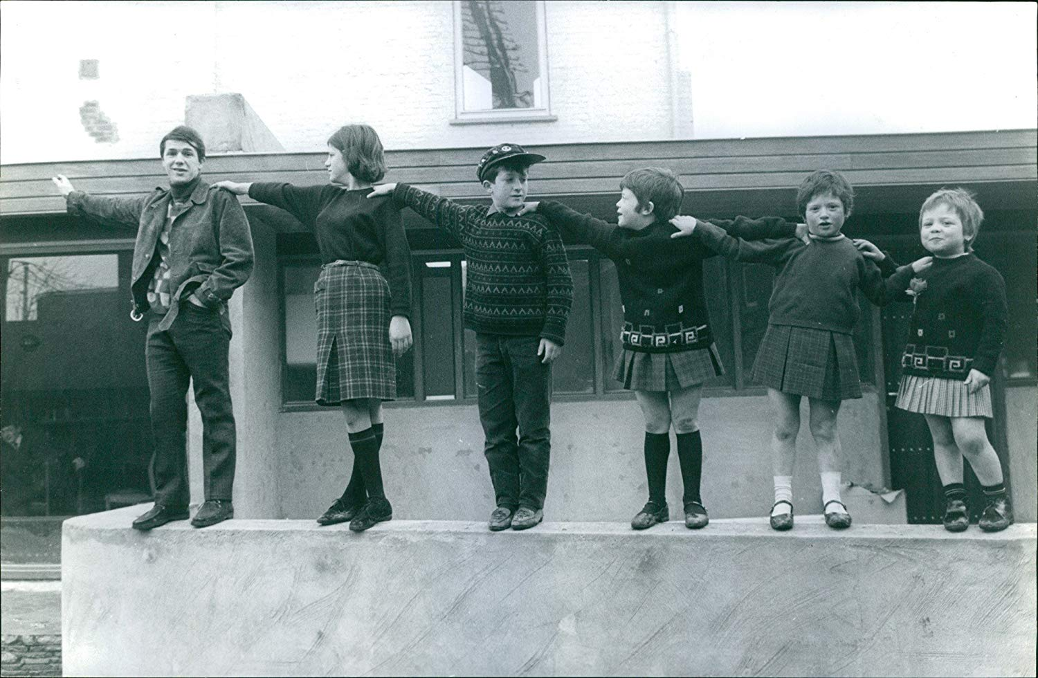
Lexicographic Order
Method of sequencing a language in which strings are grouped by their length.
Strings of shortest length will come first.

Slide 10
Example :
If Σ = {a,b}
Σ = { a, aa, aaa, aaaa,aaaaa ….}
Strings of b will not get chance to come
If Σ = {a,b}
Σ = { a, b, aa, bb, aaa, bbb, aaaa, bbbb, aaaaa ….}
Strings with a lexicographic order

Slide 11
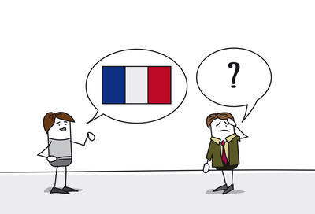
Types of Languages
Informal language (Talking languages)
Programming language
Formal Languages (Syntactic languages)

Slide 12
Informal Language
It studies purely semantic aspects of a language .
Concern with the meaning
Formal Language
It studies purely syntactical aspects of a language .
Concern with the rules /syntax and no meaning

Slide 13

Example
1: work 2: wkro
Example 1 is but correct according to the definition informal language,
Example 2 is correct according to the definition of formal language.

Slide 14
How automata accept or reject an input?
How can automata know that the given string is valid or not?
For every language rules are defined
We can say that language is already defined
Automata accepts/rejects input ,according to the predefined rules.

Slide 15
Defining Languages
The languages can be defined in different ways , such as
Descriptive definition,
Recursive definition,
using Regular Expressions(RE) and
using Finite Automaton(FA) etc.

Slide 16
1:Descriptive Definition
One of the language defining method
In this method, simply describe condition imposed on its strings/words.
The language and its associated conditions are defined in plain English.
This way is semi-formal way with chances of ambiguity.
Language name = {define equation here}

Slide 17
Example :
Define a language which should not start with zero finite string.
L1= {Any finite string of letters that doesn’t start with letter zero}

Slide 18
Example:
The language L of strings of odd length, defined over Σ={a}, can be written as
L={a, aaa, aaaaa,…..}
Example:
The language L of strings that does not start with a, defined over Σ={a,b,c}, can be written as
L={b, c, ba, bb, bc, ca, cb, cc, …}

Slide 19
Example:
The language L of strings of length 2, defined over Σ={0,1,2}, can be written as
L={00, 01, 02,10, 11,12,20,21,22}

Slide 20
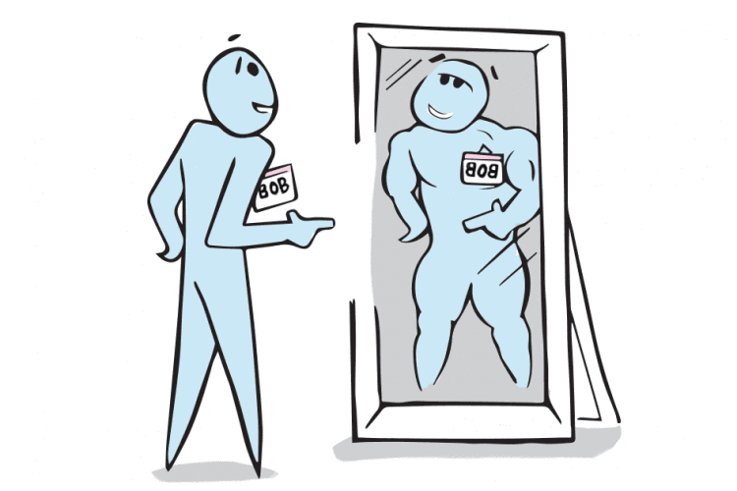
Palindrome
The language consisting of Λ and the strings s defined over Σ such that Rev(s)=s.
It is to be denoted that the words of PALINDROME are called palindromes.

Slide 21
Example:
For Σ={a,b},
PALINDROME={Λ , a, b, aa, bb, aaa, aba, bab, bbb, ...}
Null string is also a palindrome

Slide 22
2:Recursive Equation
One of the language defining method.
Fundamentally a three-step process
Rule#1:
Specify some basic objects in the set.
The number of basic objects specified must be finite.
Some basic facts about the set are written.

Slide 23
Rule#2:
Give a finite number of basic rules for constructing more objects in the set from the ones we already know.
Rule#3:
Provide declaration that no objects except those constructed in this way are allowed in the set.

Slide 24
Examples
Defining language of INTEGER
Rule 1: 1 is in INTEGER.
Rule 2: If x is in INTEGER then x+1 and x-1 are also in INTEGER.
Rule 3: No strings except those constructed in above, are allowed to be in INTEGER.

Slide 25
Defining the language L, of strings beginning and ending in different letters , defined over Σ={a, b}
Rule 1: ab and ba are in L
Rule 2: (a)s(b) and (b)s(a) are also in L, where s belongs to Σ*
Rule 3: No strings except those constructed in above, are allowed to be in L

Slide 26

Lecture Summary
Kleene Star Closure
Kleene Plus
Lexicographic order
Languages
Types of languages
Method of defining languages
Descriptive definition
Palindrome
Recursive way

